Slide 1
Machine Learning Algorithms for Breast Cancer Classification: Comparative Analysis
YASHASWINI ANAND
1RN21CS184

Slide 2
Introduction
Breast cancer is a prevalent and deadly disease among women worldwide.
Early detection and accurate classification are crucial for improving patient outcomes and reducing the burden of this disease.
Machine learning algorithms offer promising avenues for enhancing breast cancer classification, offering the potential for more rapid, accurate, and objective diagnosis.

Slide 3
Literature Review
KNN is a non-parametric method that classifies instances based on the majority class of their k-nearest neighbors in the feature space.
Decision Trees are hierarchical structures that recursively partition the feature space to maximize the homogeneity of the resulting subsets.
Logistic Regression is a linear classification algorithm that models the probability of a binary outcome using a logistic function.
Random Forests are ensemble learning methods that combine multiple decision trees to improve classification accuracy and robustness.

Slide 4
Methodology
Dataset: The Breast Cancer Wisconsin (Diagnostic) dataset, consisting of 569 instances, each representing a fine needle aspirate of a breast mass. For each instance, ten real-valued features are computed from digitized images of the mass, including texture, perimeter, area, smoothness, compactness, concavity, concave points, symmetry, fractal dimension, and diagnosis (malignant or benign).
Data Preprocessing: Handling missing values, standardizing the feature variables, splitting the dataset into training and testing sets using an 80-20 ratio, ensuring the same distribution of classes in both sets, computing the correlation matrix to understand the relationships between features.
Model Training and Evaluation: Training each algorithm on the training set and evaluating it on the testing set using key performance metrics, such as accuracy, precision, recall, and F1-score. Cross-validation and hyperparameter tuning may be employed to ensure the robustness and optimization of the results.

Slide 5
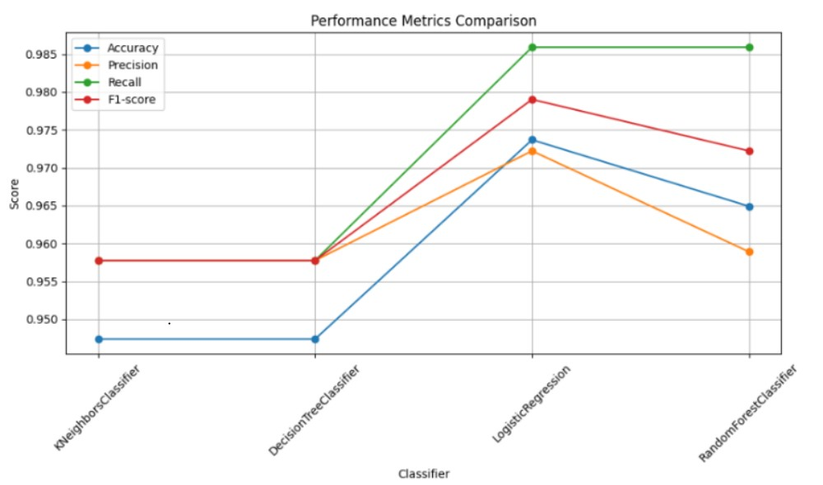
Results

Slide 6
Results
Accuracy measures the proportion of correctly classified instances out of the total instances in the dataset.
Logistic Regression achieved the highest accuracy of 97.37%, followed by Random Forests with 96.49%, KNN and Decision Trees with 94.74% each.
Logistic Regression and Random Forests outperformed KNN and Decision Trees in correctly classifying breast cancer instances.
Precision Comparison
Precision measures the proportion of true positive predictions out of all positive predictions made by the model.
Logistic Regression achieved the highest precision of 97.22%, followed by Random Forests with 95.89%, KNN and Decision Trees with 95.77% each.
Logistic Regression and Random Forests outperformed KNN and Decision Trees in minimizing false positive predictions.

Slide 7
RESULTS
Recall Comparison
Recall, also known as sensitivity, measures the proportion of true positive predictions out of all actual positive instances in the dataset.
Logistic Regression and Random Forests achieved the highest recall of 98.59%, followed by KNN and Decision Trees with 95.77% each.
Logistic Regression and Random Forests outperformed KNN and Decision Trees in capturing a significant proportion of true positive instances.
F1-score Comparison
F1-score is the harmonic mean of precision and recall, providing a balance between the two metrics1718.
Logistic Regression achieved the highest F1-score of 97.90%, followed by Random Forests with 97.22%, KNN and Decision Trees with 95.77% each.
Logistic Regression and Random Forests outperformed KNN and Decision Trees in balancing the trade-off between minimizing false positives and false negatives.

Slide 8
Discussion
Comparative Performance
Logistic Regression emerged as the top-performing algorithm in terms of accuracy, precision, and F1-score, suggesting its ability to effectively balance the trade-off between minimizing false positives and false negatives, making it a robust choice for breast cancer classification.
Random Forests also demonstrated competitive performance, particularly excelling in recall, suggesting its ability to capture complex interactions among features, resulting in high sensitivity and the ability to identify a significant proportion of true positive instances, making it a valuable tool for detecting breast cancer cases, especially those with subtle characteristics.
Interpretation of Results
The high accuracy and precision achieved by Logistic Regression indicate its ability to correctly classify breast cancer instances while minimizing misclassifications. The algorithm’s superior performance in capturing the underlying patterns and relationships within the dataset underscores its effectiveness in distinguishing between malignant and benign tumors.

Slide 9
Discussion
The high recall achieved by Random Forests indicates its ability to identify a significant proportion of true positive instances, especially those with subtle characteristics. The algorithm’s ensemble nature enables it to capture complex interactions among features, resulting in high sensitivity and robustness.
Clinical Implications
The findings of our study have important implications for clinical practice, particularly in the domain of breast cancer diagnosis and treatment.
The high accuracy and reliability exhibited by Logistic Regression and Random Forests suggest their potential utility as decision support tools for healthcare practitioners.
Integrating these machine learning algorithms into clinical workflows could aid in improving diagnostic accuracy, facilitating early detection, and guiding personalized treatment strategies.

Slide 10
Thank you

